Slide 1

Project Report
Instagram Data Analytics
Mukesh Dey

Slide 2

01 - Introduction
02 - Marketing Analytics
03 - Investors Metrics
Data
Analytics

Slide 3
01 - Introduction
Analyzing data enables informed decision-making
In this project, I'll be using SQL and MySQL Workbench as my tools to analyze Instagram user data and answer questions posted by the management team. My insights will help the product manager and the rest of the team make informed decisions about the future direction of the Instagram app.
Data
My findings could potentially influence the future development of one of the world's most popular social media platforms.
Analytics

Slide 4

02 - Marketing Analysis
  Loyal User Reward.
  Inactive User Engagement.
  Contest Winner Declaration.
  Hashtag Research.
  Ad Campaign Launch.

Slide 5
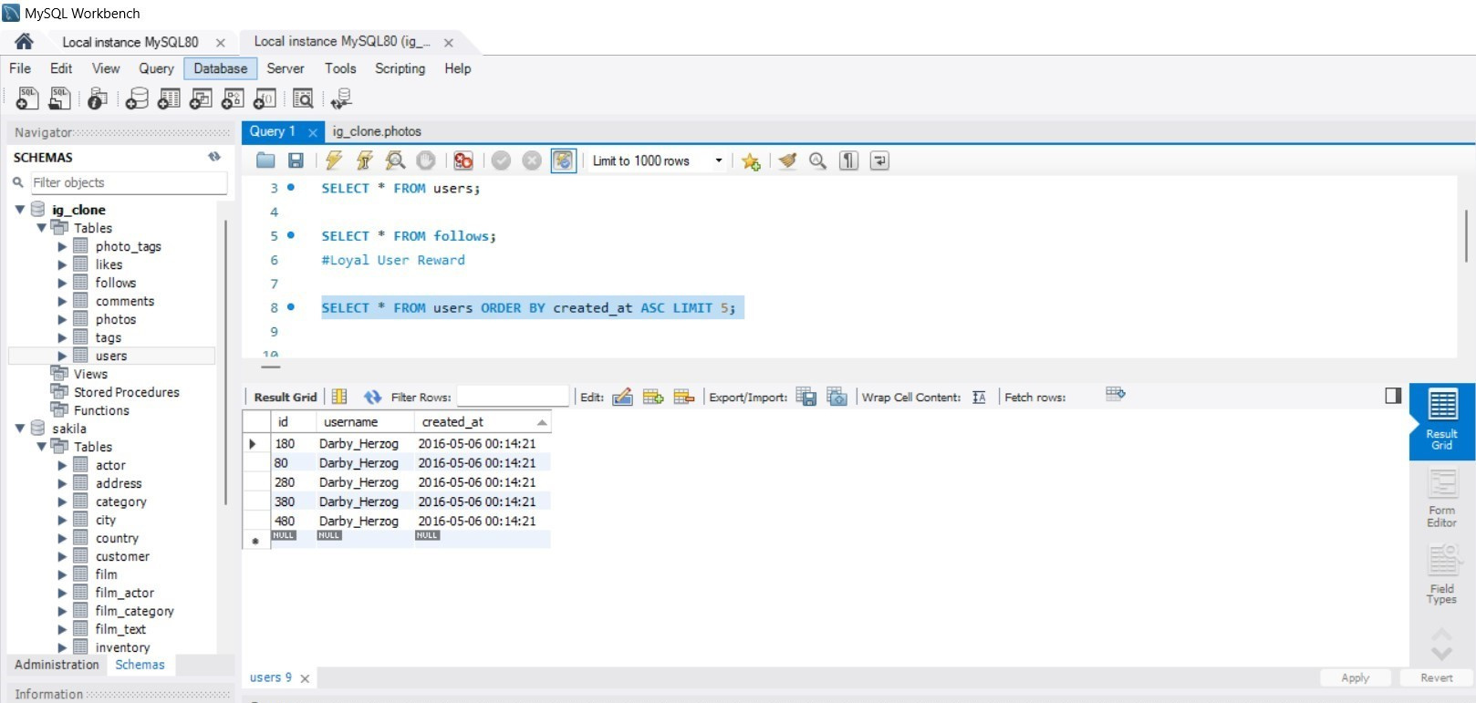
  Loyal User Reward
The marketing team wants to reward the most loyal users, i.e., those who have been using the platform for the longest time. So for that the loyal reward will be given to five oldest users on Instagram.
So, here’s the top 5 oldest users on Instagram.
Data
Analytics

Slide 6
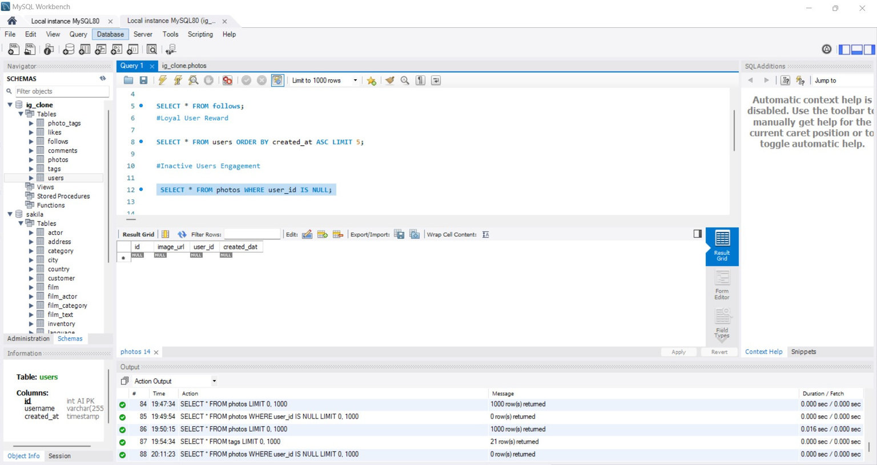
  Inactive User Engagement
The team wants to encourage inactive users to start posting by sending them promotional emails. So, here’s the users who have never posted a single photo on Instagram.
But, there’s no user without a single photo posted on Instagram
Data
Analytics

Slide 7
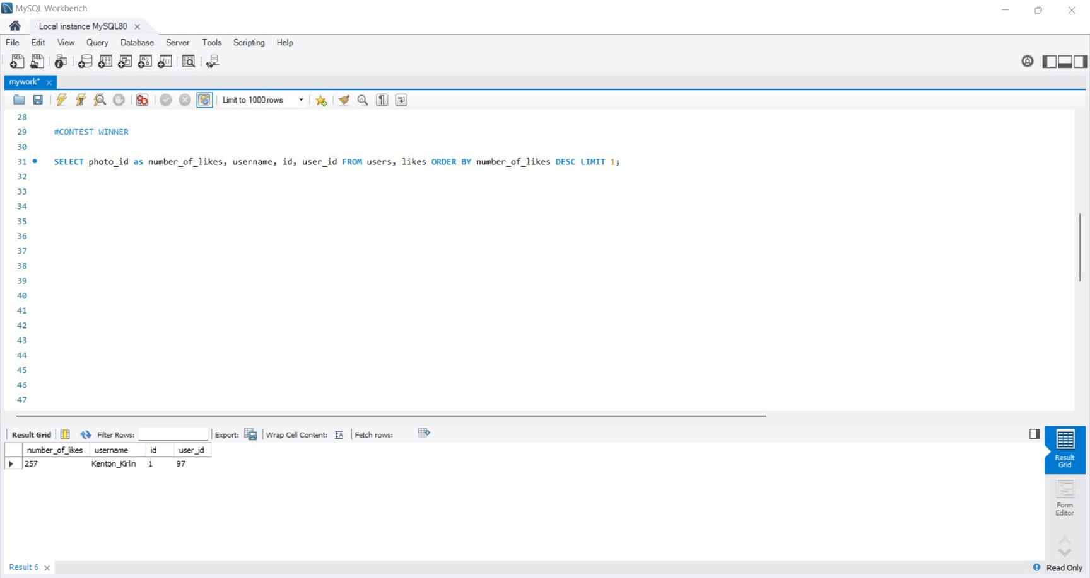
  Contest Winner Declaration
The team has organized a contest where the user with the most likes on a single photo wins. So, I have to determine the winner of the contest and provide their details to the team.
Here’s the user with most no. of likes in a single photo.
Data
Analytics

Slide 8
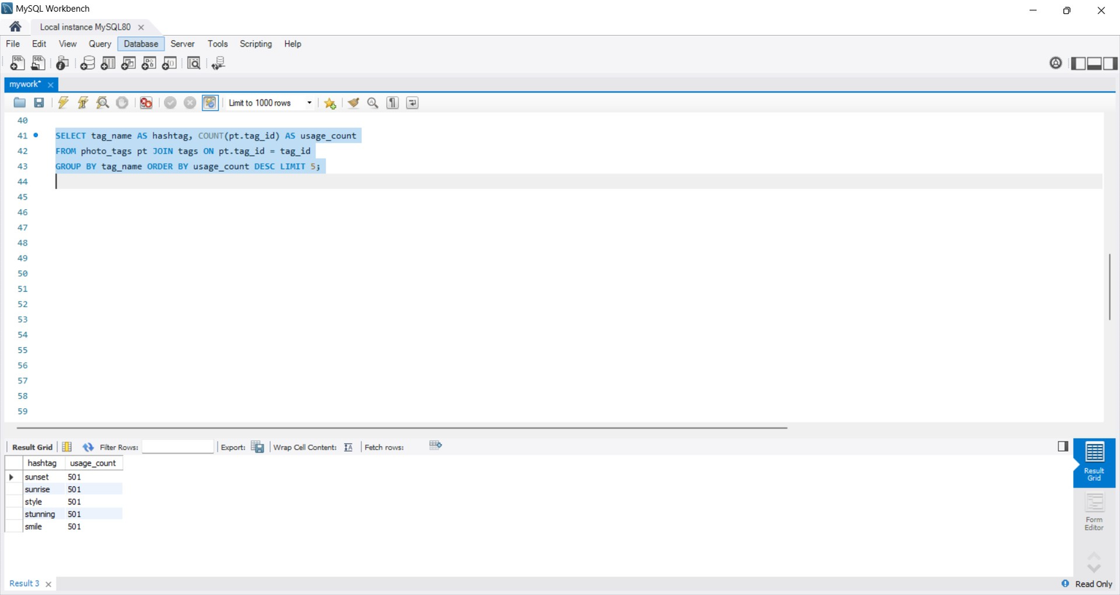
  Hashtag Research
A partner brand wants to know the most popular hashtags to use in their posts to reach the most people. So, team want to know the top five most commonly used hashtags on the platform.
Here’s the top five most used hashtags on the Instagram.
Data
Analytics

Slide 9
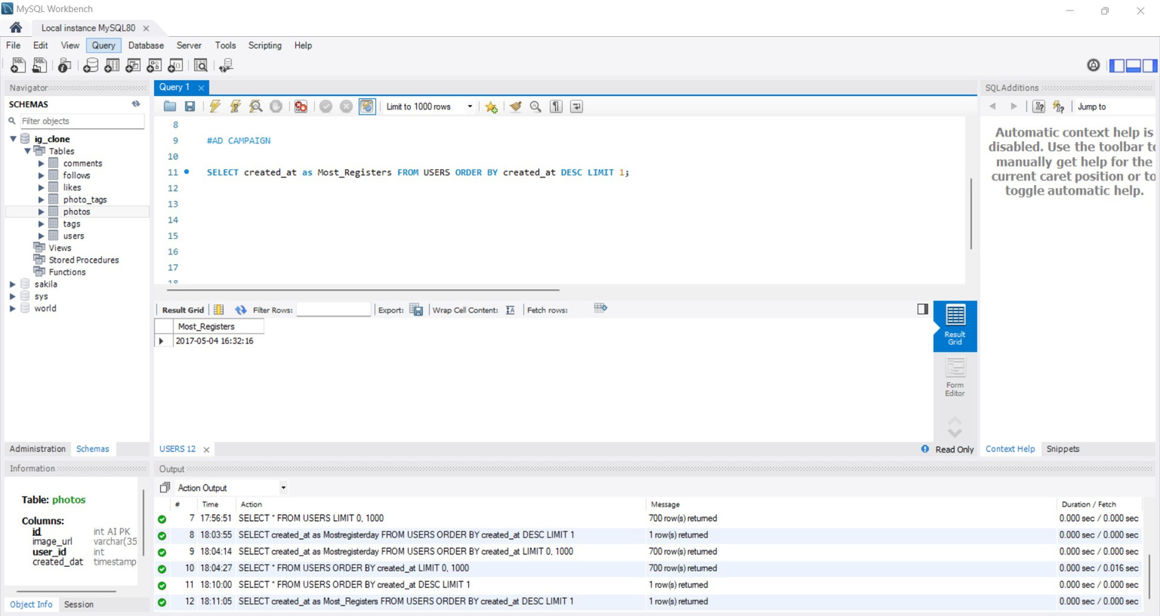
  Ad Campaign Launch
The team wants to know the best day of the week to launch ads. So. they wants to know the day of the week when most users register on Instagram for scheduling the ad campaign.
The day on which most number of users registered on the Instagram.
Data
Analytics

Slide 10

03 - Investor Metrics
  User Engagement.
  Bots & Fake Accounts.
Data analysis allows for identifying trends and patterns within datasets.

Slide 11
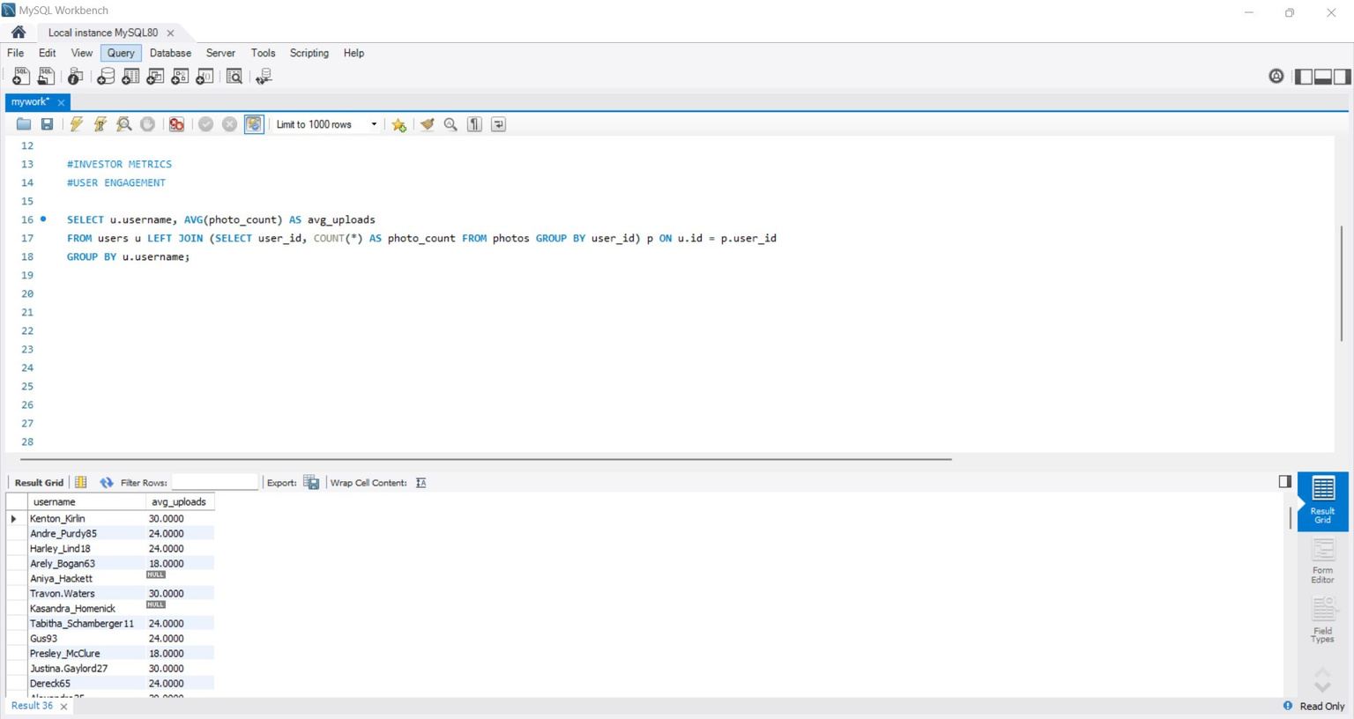
  User Engagement
Investors want to know if users are still active and posting on Instagram or if they are making fewer posts. So they wants me to calculate the average number of posts per user on Instagram and also to provide the total number of photos on Instagram divided by the total number of users.
Here’s the average number of posts per user on Instagram
Data
Analytics

Slide 12
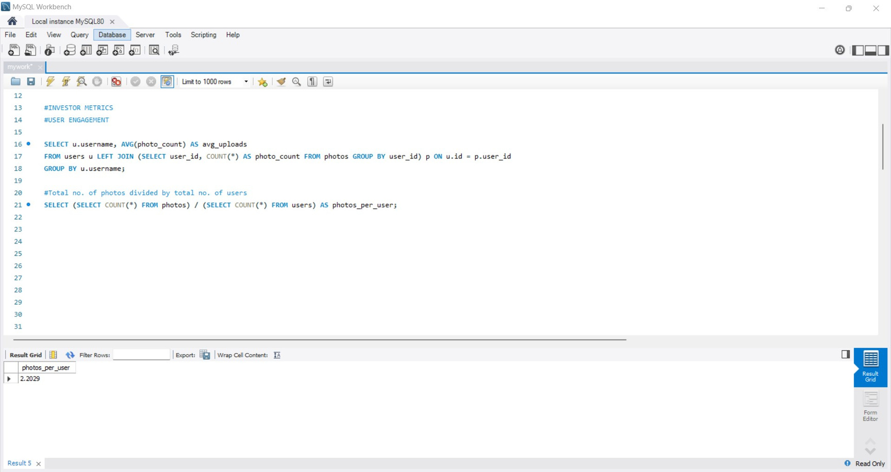
  User Engagement
Here’s the total number of photos on Instagram divided by the total number of users.
Data
Analytics

Slide 13
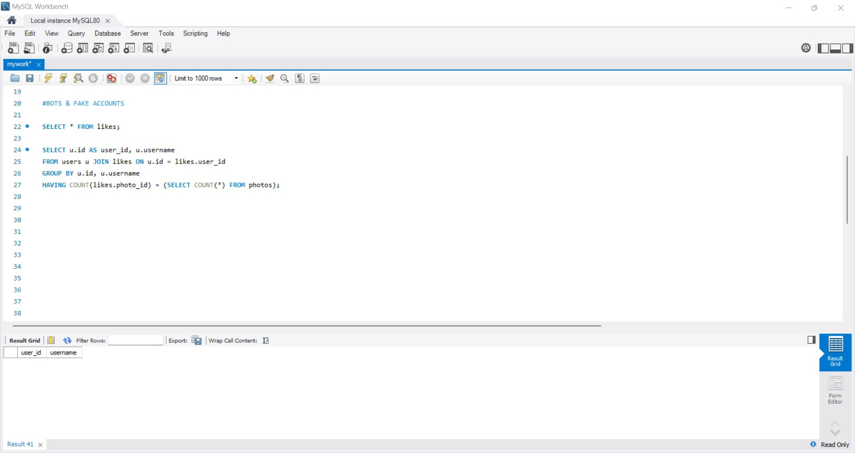
  Bots & Fake Accounts
Investors want to know if the platform is crowded with fake and dummy accounts. So, wants me to identify users (potential bots) who have liked every single photo on the site, as this is not typically possible for a normal user.
Here’s the output for bots & fake accounts. As all the users are genuine so the output is blank.
Data
Analytics

Slide 14

Thanks
Mukesh Dey

